Slide 1
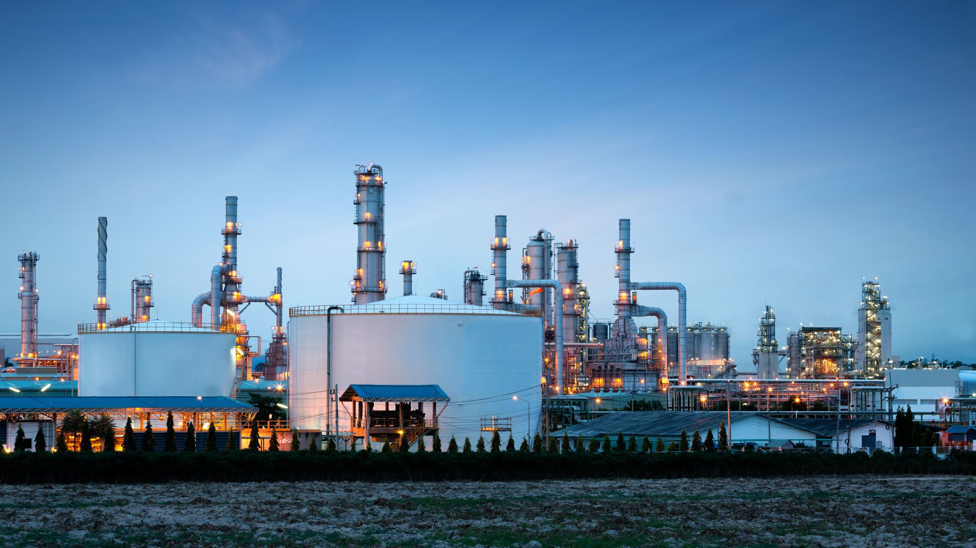
Industrial Management
UNIT-II
Production and Productivity

Slide 2
Production
Production is a sequence of technical processes requiring either directly or indirectly the mental and physical skill of craftsman and consists of changing the shape, size and properties of materials and ultimately converting them into more useful articles.
"an organised activity of transforming raw materials into finished products"
"producing goods which satisfies some human wants"

Slide 3
Types of Production
For production control, we adopt two types of production
Intermittent Production
Continuous Production

Slide 4
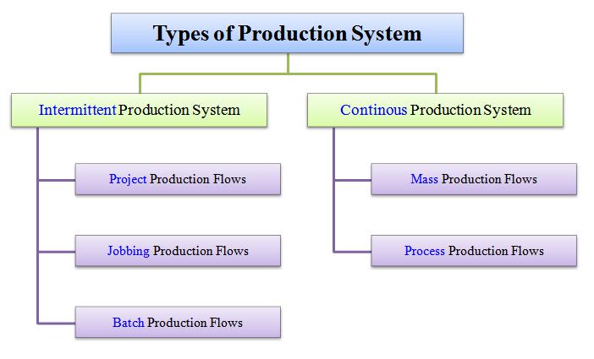
Types of Production

Slide 5
Intermittent Production
If a machinery set up is used for only a short time and then changed for some other different product, this is known as intermittent production method. It consists of variety of products for short runs.
In this system goods are manufactured according to the orders made by customers. In this system, the production facilities are flexible enough to handle a wide variety of products and sizes and can be used to manufacture those products where the basic nature of inputs changes with the change in the design and sizes of the product.
EX-Welding shops, machine shops, hospitals etc.,

Slide 6
Characteristics of an Intermittent Production System
Products are produced in small quantities
Process Layout or Functional layout is needed
Workload is different in different departments
Highly skilled operators are needed
Many job instructions are needed
Raw material inventories are high
Require more floor space, storage space etc.,
General purpose machines are preferred

Slide 7
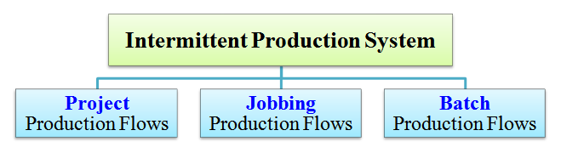
Intermittent Production

Slide 8

Project Production
Project production is usually the production of a single complete unit by one operator or group of operators
Ex-House Construction, Bridge or Dam Construction, Shipbuilding, railway coach building etc.,

Slide 9
Intermittent Production Project Production-Characteristics
Whole work is taken as a single project
The work is split into small activities or products for operational convenience
Work is to be completed on each product or activity before processing the next
Versatile and skilled labour is needed
High Capital investment is required
Control operations are relatively simple
High unit cost of production

Slide 10
Intermittent Production Job order production
Job order production is also the production of products to meet specific customer requirements. The quantity involved is small, usually one or a few. This type of production is mainly concerned with special small projects, models, prototypes, special machinery equipment to perform specialised and specific tasks, components or subassemblies to provide replacement or repairs in existing machinery, etc.,
Ex-Repairing, printing of pamphlets, stitching of dresses by tailor, Grills for houses

Slide 11
Intermittent Production Job order production-Characteristics
General purpose machinery
Process layout of plant and equipment
High skill
High quality of supervision
Low quantity but a large variety of raw materials
High cost of production
Make to order
Customer dominant system
Fluctuating demand
Small production runs
Discontinuous flow of materials
Long production cycle time

Slide 12
Intermittent Production Job order production
According to the regularity of manufacture, job production can be described in the following three categories
One-time Job production
Ex-Set made in a studio for shooting a movie, Necklace manufactured by a goldsmith
Periodic Job production
Ex-Milk vendor supplying milk every morning and inspection(servicing) of motorcycle
Need based Job production
Dress stitched by a tailor and typist's job

Slide 13
Intermittent Production Batch production
Production schedule can be made according to specific order or on the basis of demand forecast. The items are produced in lots or batches. New batch is undertaken for production only when the work on all the items of a batch is completed.
This system is adopted by some of the industries like food industry, chemical industry, electronics instruments, machine tools, printing press etc.

Slide 14
Intermittent Production Batch production-Characteristics
Camparing with mass production ,it
required less investment
Made to stock
Frequent changes in Planning
Semi-skilled labour
Quality of Supervision
Plant Layout
Material handling
Flexibility in Production Schedule
Medium size enterprises
General purpose and One purpose machines
Two or more type of products are manufactured in lots at regular intervals
Short runs
Ex-Readymade garments, Mineral water bottles, Paints & most of the engineering companies adopt

Slide 15
Continuous Production/Flow Production
It is most useful for prodcuct of repetitive nature. Each work is passed to the next stage immediately after the previous operation is completed without waiting for the finishing work as a total batch.
For the smooth flow of work ,the time that the task requires to be spent on each stage must be of equal length.
As the whole system is balanced , any error at a particular stage affects not only that stage but also other stages in the flow line.

Slide 16
Continuous Production/Flow Production Characteristics
Continuous flow of material
High capital investments and less cost of production
Product-type Plant Layout
Special purpose machines
Less Material handling and automation
Less variety and huge quantities
Low skill of workers
Short production cycle time
Less supervision
Machine breakdown and absenteeism

Slide 17
Continuous Production/Flow Production Suitability
Substantially constant demand
Product of task must be standardized
Materials must be to specification and delivered in time
Task must be defined
Work must confirm to quality standards
Correct plant and equipment must be provided at each stage
Maintenance must be by Anticipation, not Default
Inspection must be 'In Line' with Operation
All stages must be Balanced

Slide 18
Types of Continuous/Flow Production
Mass Production
Process Production
Assembly Lines

Slide 19
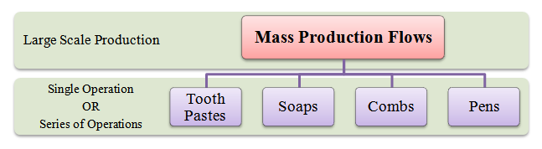
Types of Continuous/Flow Production Mass Production
Mass production refers to the manufacture of standardized parts or components on a large scale. Standardization of materials, machines, products and processes is the basic feature of mass production. The parts manufactured under mass production are combined in assembly line for making different products. Generally the degree of mechanization and automation is high. The mass production process is continuous.

Slide 20
Types of Continuous/Flow Production Mass Production-Characteristics
Standardization of product and process sequence
Special purpose machines having higher production capacities and output rates
Large volume of products
Shorter cycle time of production
Lower in process inventory
Perfectly balanced production lines
Flow of materials, components and parts is continuous
Production Planning and Control is easy
Material handling can be completely automatic

Slide 21
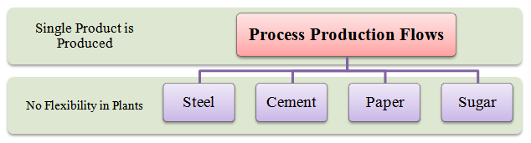
Types of Continuous/Flow Production Process Production
Under this type of flow production, production is carried on continuously through a uniform and standardized sequence of operations. Highly sophisticated and automatic machines are used. Process production is employed in bulk processing of certain materials. Here, single raw material can be transformed into different kinds of products at different stages of the production process e.g., processing of crude oil in refinery — we get kerosene, gasoline, etc., at different stages of production. Similarly, sugarcane is processed into sugar and molasses. In the automobile industry, process production is used in making chassis. Chemicals, cement, etc. are other examples of process production industries. Plants employing process production system are known as ‘process plants’.
A single product is produced and stocked in warehouses until it is demanded in the market. The flexibility of these plants is almost zero because only one product can be produced.
Ex- steel, cement, paper, sugar, etc.

Slide 22
Types of Continuous/Flow Production Process Production
On the basis of the nature of production process, flow of production may be classified into
Analytical process of production and
Synthetic process of production.
Analytical Process of Production: In analytical process of production, a raw material is broken into different products. For example, crude oil is analyzed into gas, naphtha, petrol, etc. Similarly, coal is processed to obtain coke, coal, gas, coal-tar, etc.
Synthetic process of production: Synthetic process of production, on the other hand, involves the mixing of two or more materials to manufacture a product. For instance, lauric acid, myristic acid, plasmatic acid, stearic acid, linoleic acid, etc., are synthesized to manufacture soap.

Slide 23
Types of Continuous/Flow Production Process Production-Characteristics
There is a highly mechanized system for handling materials. Conveyors and automatic transfer machines are used to move the materials from one stage to another.
Low-skilled labor and skilled technicians are required.
There is very less work-in-progress because material flow is continuous.
The production planning and scheduling can be decided well in advance.
The full production system is designed to produce only one specific type of item.

Slide 24
Types of Continuous/Flow Production Assembly Line Production
Assembly line is a type of production which developed in the automobile industry in the U.S.A. A manufacturing unit prefers to develop and employ assembly line because it helps to improve the efficiency of production. The use of flow production methods results in cost reduction. Assembly line is particularly useful when a limited variety of similar products is to be produced on a mass scale or in fairly large batches on a regular or continuous basis. In any production system the most vital decision is the proper layout of assembly line. The design of assembly line involves the proper balancing of technology and other manufacturing facilities so as to develop a rational approach for optimization of results. The assembly line design depends largely upon product design and location of production.

Slide 25
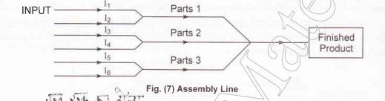
Types of Continuous/Flow Production Assembly Line Production

Slide 26
Comparison between various Production Systems
Level of Production
Pattern of Organization
Production Cost per Unit
Production flexibility
Decision Making
Required Skills and abilities
Employment
Suitability

Slide 27
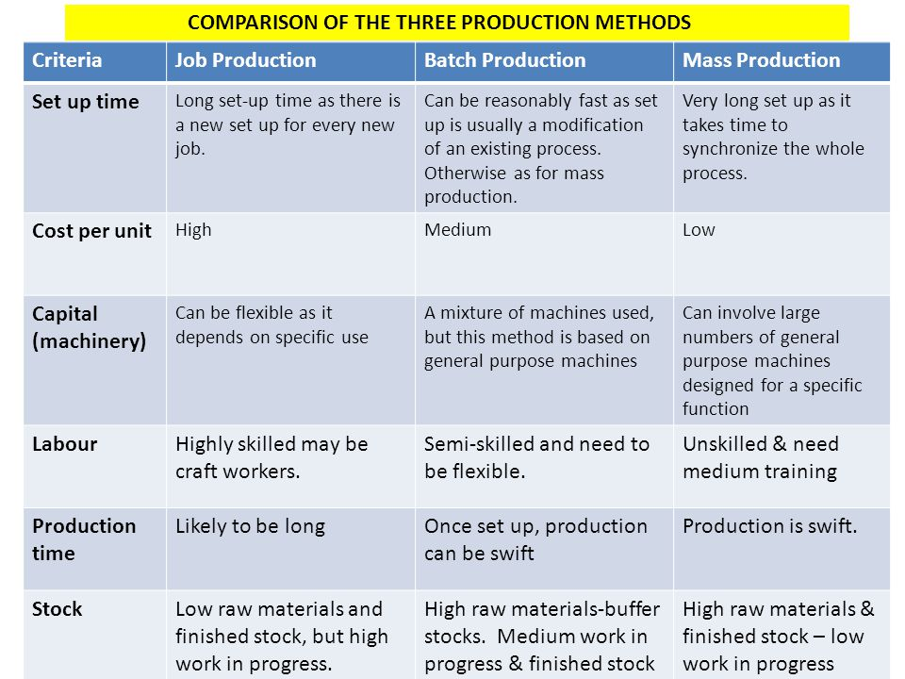
Comparisons between various Production Systems

Slide 28
Productivity
Productivity implies development of an attitude of mind and a constant urge to find better, cheaper, easier, quicker and safer means of doing a job, manufacturing a product and providing a service.
V.K.R Menon
Productivity is defined as the ratio of output to input of a production system,
Productivity - OutPut
Inputs

Slide 29
Productivity
To increase productivity, we want to make this output to inputs as large as possible which can be practical. This can be achieved by :
Either producing more output with the same inputs.
Or using fewer inputs for the same outputs.
Productivity-is a common measure of how well a country, industry or business unit is doing using its resources or factors of production

Slide 30
Productivity and Production
The concept of productivity and production are totally different
Production refers to absolute measure of output whereas productivity is a relative term.
In productivity output is expressed in terms of input
Production may show a rise without corresponding rise in the productivity and vice versa
Rising productivity does not necessarily mean an increase in production

Slide 31
Productivity and Profitability
Profitability is the ratio of difference of revenue and cost to Investment
Profitability = Revenue-Cost/Investment.
Profitability can be increased by reducing costs which in turn also increases productivity.
Profitability can be increased by increasing selling price

Slide 32
Purpose and Benefits of increasing Productivity
For Management
(i) To earn good profit because of reduction in costs.
(ii) To sell more, to earn profit.
(iii) To have better utilization of resources.
(iv) To stand better in the market.
(v) Provide overall prosperity and reputation of the company.

Slide 33
Purpose and Benefits of increasing Productivity
For Workers
(i) Higher wages.
(ii) Better working conditions, improved morale.
(ii) Higher standard of living.
(iv) Job security and satisfaction.
For Consumers
(i) Better quality goods at reduced prices which helps to raise their standard of living.
(ii) More satisfaction.

Slide 34
Purpose and Benefits of increasing Productivity
To Government
(i) Higher profits earned by factories will bring more revenue to the government by taxation.
(ii) Export trades may develop bringing more foreign exchange to the nation.
(iii) It helps to increase the welfare of the nation and development of national economy.
(iv) It helps better utilization of resources of the nation.
(v) It increases per capita income.
(vi) Development of the nation.

Slide 35
Factors affecting Productivity
Technological Development
Size of the Plant
Research and Development
Plant and Job Layout
Machine and Equipment Design
Production Processes
Power, Raw materials etc.,
Scientific Management

Slide 36
Factors affecting Productivity
Individual factors
Organization factors
Work environment
Other factors
Natural factors
Managerial factors
Government policy

Slide 37
Increasing Productivity of Resources
Material
Labour
Plant Equipment and Machinery
Land and Buildings

Slide 38
Importance of Productivity
To Beat the Competition
Guide to Management
Strategic
Tactical
Planning
Administration
Indicator of Progress

Slide 39
Increasing Productivity of Resources
Maximum Utilization of Scarce Resources
Key to National Prosperity
Prosperity to Labour
Other uses

Slide 40
Techniques of Increasing Productivity
Product Development
Specialization and Standardization
Market, Consumer and Product Research
Value Analysis
Process Planning and Research
Method Study
Work Measurement
Operator Training

Slide 41
Techniques of Increasing Productivity
Production Planning and Control
Material Control
Plant Maintenance
Improved Working Conditions
Safety
Personnel Policy
Incentives

Slide 42
Procedure for Increasing Productivity
Improving the Existing Method of Plant Operation
Purpose of Operation
Design of Part
Tolerance and Specifications
Effective utilization of Materials

Slide 43
Procedure for Increasing Productivity
Process of Manufacture
Set-up and tools
Working Conditions
Material Handling
Plant Layout

Slide 44
Kinds of Productivity
There are three major types of Productivity measures
Partial Productivity
Total Factor Productivity
Total Productivity

Slide 45
Kinds of Productivity
Partial Productivity
Partial productivity is the ratio of output to one class of input among many factors of production.
Labour Productivity= Output____
Labour Input
In terms of Hours
Productivity(Efficiency) = Production in Standard hours
Actual Man hours
In terms of Money
Productivity = Total cost(or Sales value) of output
Number of workers

Slide 46
Kinds of Productivity
Material Productivity= Output ____
Material Input
Productivity = Material cost______
Number of units produced
Machine Productivity = Output in standard hours
Actual machine hours
Selling, Distribution or Administrative Productivity
Productivity = Selling, distribution or Administrative cost
Total Sales
Capital Productivity = __Output______
Capital employed
Return of Capital employed = Profit________
Capital employed

Slide 47
Kinds of Productivity
Total Factor Productivity
Total factor productivity is the ratio of net output to the sum of associated labour and capital (factor) inputs. Net output means output minus material, capital, energy and other input expenses.
Total Factor Productivity =__ Net Output__________
Labour Inputs + Capital Inputs

Slide 48
Kinds of Productivity
Total Productivity
Total productivity is the ratio of total output to the sum of all input factors.
Total Productivity = Total Tangible(measurable) Output
Total Tangible Input
Total tangible output = Value of finished goods+ value of partially finished units+ dividends from securities + Interest + other income
Total tangible input = Value of human, material, capital, energy and other inputs used
General Measure of Productivity = Output
Input

Slide 49
Productivity Index
Productivity Index is used to compare the productivity during the current year with the productivity during the base year. Base year is any year which the company uses for comparative study.
Productivity Index = Productivity during the current year
Productivity during the base period

